Slide 1
Cheap
Shots

Slide 2
NoAnusOnly.com
Where 1 in 4 People Find Love!

Slide 3
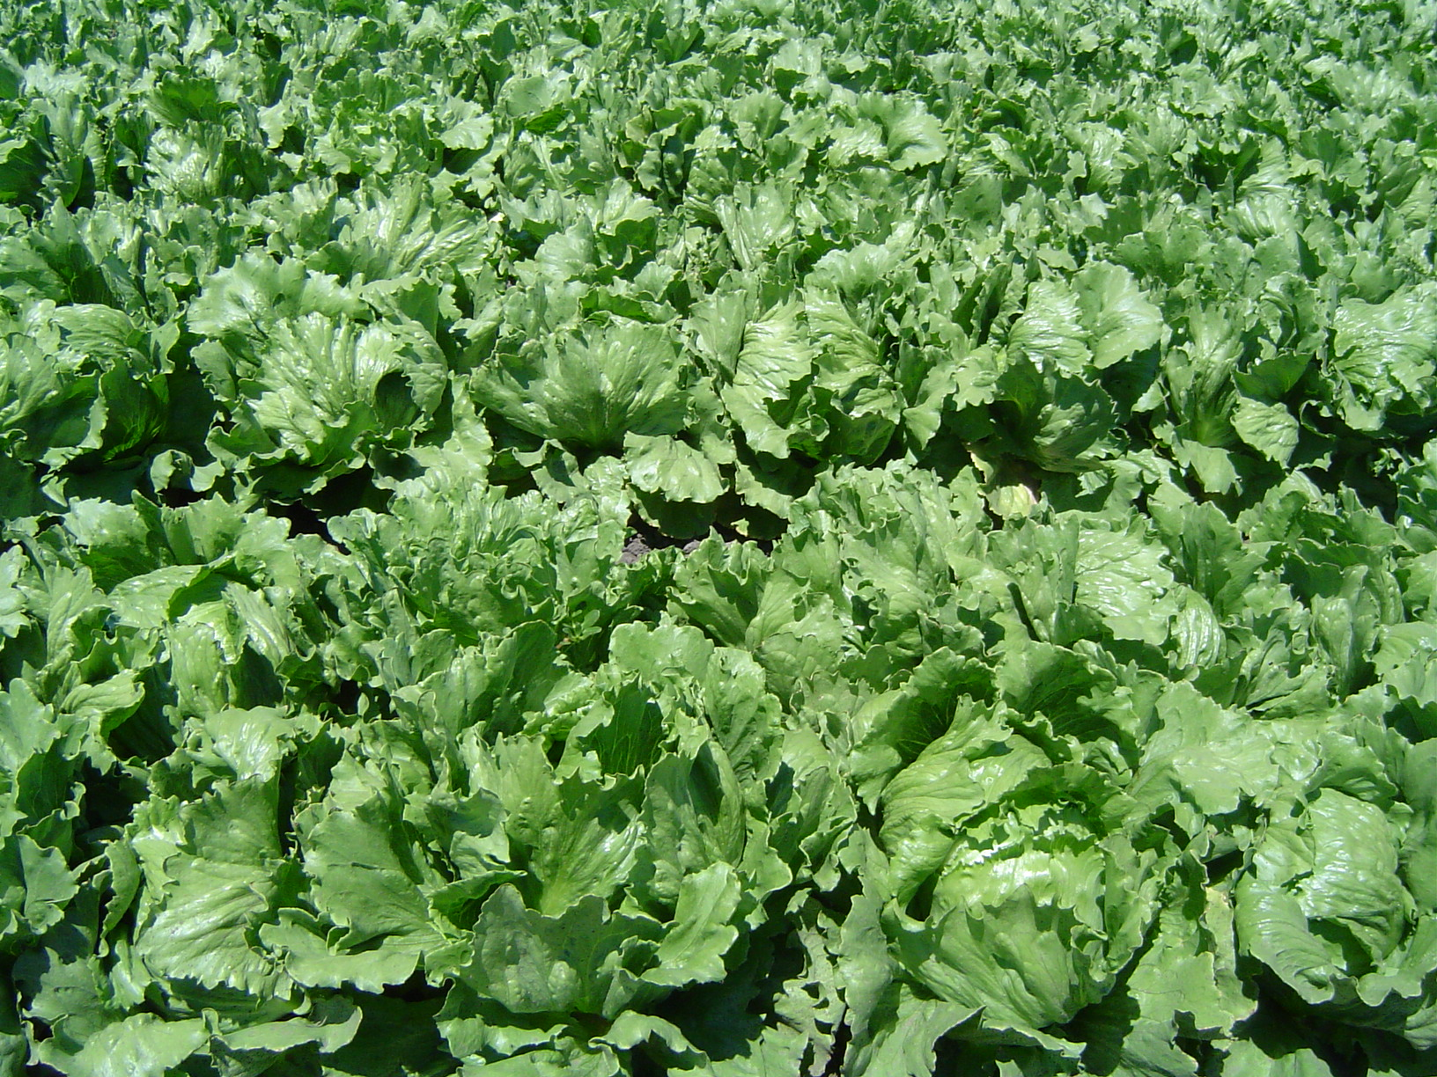
ASS
WHOLE FOODS
Market
FUCK YOU

Slide 4
ASS
WHOLE FOODS
Market

Slide 5


Slide 6
ASS
WHOLE FOODS
Market
FUCK K-MART

Slide 7
ASS
WHOLE FOODS
Market
QUIT BEING A LITTLE BITCH

Slide 8
ASS
WHOLE FOODS
Market
PIECE OF SHIT

Slide 9
ASS
WHOLE FOODS
Market
JUST THROAT PUNCH ‘EM

